Slide 1
Chapter 11 EC Strategy and Implementation: Justification, Globalization, SMEs, and Regulatory

Slide 2
LEARNING OBJECTIVES
Describe the strategic planning process.
Describe the purpose and content of a business plan in e-commerce.
Describe EC strategy implementation including the use of metrics.
Describe the need for justifying EC investments, how it is done, and how metrics are used to determine justification.
Understand the difficulties in measuring and justifying EC investments.
Evaluate the issues involved in global EC.

Slide 3
LEARNING OBJECTIVES
Analyze the impact of EC on SMEs.
Understand the foundations for legal and ethical issues in EC.
Explain privacy, free speech, and defamation and their challenges.
Discuss the challenges caused by spam, splogs, and pop-ups.
Describe the importance of green EC and the major issues of concern.
Describe the anticipated future of EC.

Slide 4
STRATEGY, PLANNING, AND IMPLEMENTATION OF E-COMMERCE
strategy
A broad-based formula for how a business is going to accomplish its mission, what its goals should be, and what plans and policies will be needed to carry out those goals.

Slide 5
STRATEGY, PLANNING, AND IMPLEMENTATION OF E-COMMERCE
STRATEGY AND THE WEB ENVIRONMENT
Porter’s Competitive Forces Model and Strategies
Threat of entry of new competitors
Bargaining power of suppliers
Bargaining power of customers or buyers
Threat of substitute products or services
Rivalry among existing firms in the industry
e-commerce strategy (e-strategy)
The formulation and execution of a vision of how a new or existing company intends to do business electronically.

Slide 6
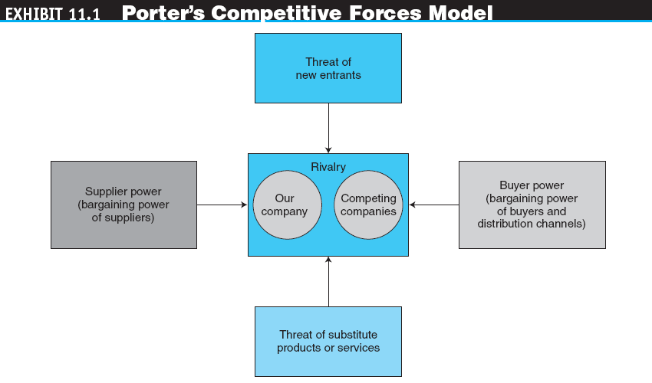

Slide 7
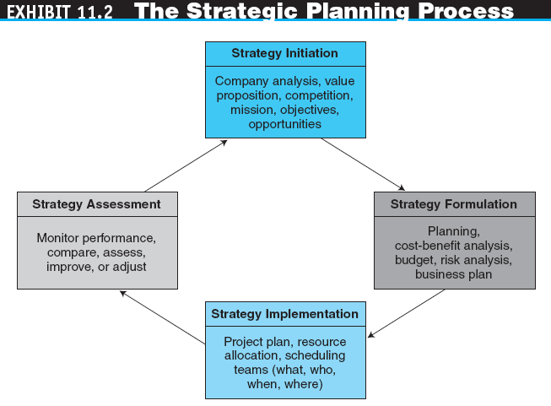

Slide 8

Copyright © 2011 Pearson Education, Inc. Publishing as Prentice Hall
11-7
STRATEGIC PLANNING TOOL
SWOT analysis (Strength, Weakness, Opportunities, Threat)
A methodology that surveys external opportunities and threats and relates them to internal strengths and weaknesses
Notes:
7

Slide 9
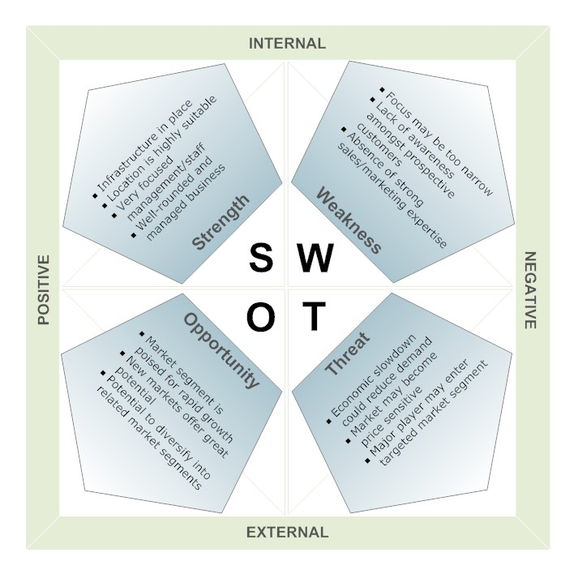
Copyright © 2010 Pearson Education, Inc. Publishing as Prentice Hall
11-8
Notes:
8

Slide 10
STRATEGY, PLANNING, AND IMPLEMENTATION OF E-COMMERCE
strategy initiation
The initial phase of strategic planning in which the organization examines itself and its environment.
Specific outcomes:
value proposition
The benefit that a company’s products or services are provided to a company and its customers.
Core competencies
Forecasts
Competitor (industry) analysis (e.g. SWOT)

Slide 11
STRATEGY, PLANNING, AND IMPLEMENTATION OF E-COMMERCE
strategy formulation
The development of strategies to exploit opportunities and manage threats in the business environment in light of corporate strengths and weaknesses.
Specific activities and outcomes:
Business opportunities
Cost-benefit analysis
Risk analysis, assessment, and management
Business plan

Slide 12
STRATEGY, PLANNING, AND IMPLEMENTATION OF E-COMMERCE
strategy implementation
The development of detailed, short-term plans for carrying out the projects agreed on in strategy formulation.
Specific activities and outcomes:
Project planning
Resource allocation
Project management

Slide 13
STRATEGY, PLANNING, AND IMPLEMENTATION OF E-COMMERCE
strategy assessment
The continuous evaluation of progress toward the organization’s strategic goals, resulting in corrective action and, if necessary, strategy reformulation.

Slide 14
STRATEGY, PLANNING, AND IMPLEMENTATION OF E-COMMERCE
BUSINESS PLANNING IN E-COMMERCE
business plan
A written document that identifies a company’s goals and outlines how the company intends to achieve the goals and at what cost.

Slide 15
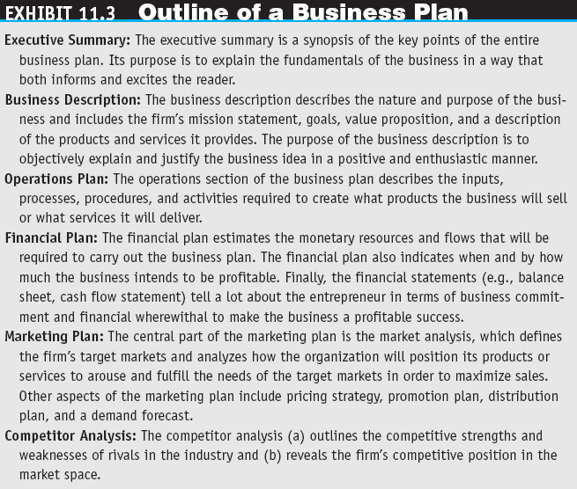

Slide 16
STRATEGY, PLANNING, AND IMPLEMENTATION OF E-COMMERCE
business case
A business plan for a new initiative or large, new project inside an existing organization.
E-COMMERCE STRATEGY: CONCEPTS AND OVERVIEW
Strategy in the Web 2.0 Environment and in Social Networking

Slide 17
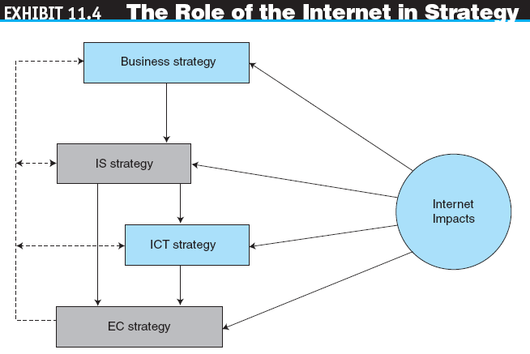

Slide 18
JUSTIFICATION AND COST-BENEFIT ANALYSIS
Companies need to justify their EC investments as part of strategy formulation in order to achieve the optimal level of investment
OTHER REASONS WHY EC JUSTIFICATION IS NEEDED
EC is not necessarily the solution to all problems
Formal evaluation of requests for funding mandated
Need to assess the success of EC projects after completion
Success of EC projects assessed in order to pay bonuses
Pressure from top management
Large amount of money
Weak business conditions exist

Slide 19
JUSTIFICATION AND COST-BENEFIT ANALYSIS
EC INVESTMENT CATEGORIES AND BENEFITS
HOW IS AN EC INVESTMENT JUSTIFIED?
cost-benefit analysis
A comparison of the costs of a project against the benefits.
WHAT NEEDS TO BE JUSTIFIED? WHEN SHOULD JUSTIFICATION TAKE PLACE?

Slide 20
JUSTIFICATION AND COST-BENEFIT ANALYSIS
USING METRICS IN EC JUSTIFICATION
metric
A specific, measurable standard against which actual performance is compared.
key performance indicators (KPIs)
The quantitative expression of critically important metrics.

Slide 21
DIFFICULTIES IN MEASURING AND JUSTIFYING E-COMMERCE INVESTMENTS AND SUCCESS
THE EC JUSTIFICATION PROCESS
DIFFICULTIES IN MEASURING PRODUCTIVITY AND PERFORMANCE GAINS
Data and Analysis Issues
EC Productivity Gains May Be Offset by Losses in Other Areas
Incorrectly Defining What Is Measured
Other Difficulties

Slide 22
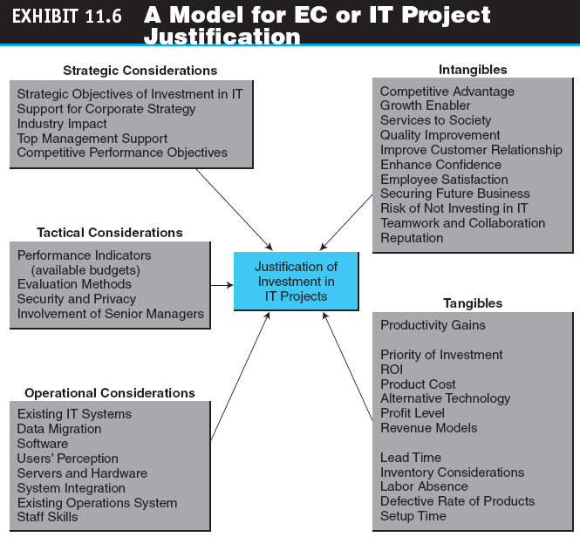

Slide 23
DIFFICULTIES IN MEASURING AND JUSTIFYING E-COMMERCE INVESTMENTS AND SUCCESS
Why Projects Failed?
One IT web performed dynamic market survey of 800 IT managers found:
62 percent of IT projects fail to meet their schedules
49 percent suffered budget overruns
47 percent had higher-than-expected maintenance costs, and
41 percent failed to deliver the expected business value and ROI
11-22
Notes:
22

Slide 24
DIFFICULTIES IN MEASURING AND JUSTIFYING E-COMMERCE INVESTMENTS AND SUCCESS
DETERMINING E-COMMERCE SUCCESS
Product Characteristics
Industry Characteristics
Seller Characteristics
Consumer Characteristics

Slide 25
DIFFICULTIES IN MEASURING AND JUSTIFYING E-COMMERCE INVESTMENTS AND SUCCESS
Internet Bubble (2000-2001) - Burst
Market crash cost investors around US$5 Trillion
2 Key reasons WHY :
The Use of Metrics That Ignored Cash Flow : Many investors ignored the fundamental rules of stock market investment, like analyzing P/E ratio, studying market trends, and reviewing business plans
Significantly Overvalued Stocks : other than focusing on unnecessary metrics, analysts used very high multipliers in their models and formulas for valuing Internet companies, which resulted in unrealistic and overly optimistic values
11-24
Notes:
24

Slide 26
DIFFICULTIES IN MEASURING AND JUSTIFYING E-COMMERCE INVESTMENTS AND SUCCESS
Internet Bubble 2.0 ?
Facebook (IPO price US$38, at 14 Jun 16 $114.90)
Acquired Whatsapp in 2014 at $19,000,000,000
Acquired Instagram in 2013 at $1,000,000,000
YouTube (acquired by Google, Google IPO price US$85, at 14 Jun 16 $718.27)
Twitter (IPO price US$26, at 14 Jun 16 $15.36)
LinkedIn (IPO price US$45, at 14 Jun 16 $191.63)
Yahoo (IPO price US$24.50, at 16 Jun 16 $37.39)
eBay (IPO price US$18, at 16 Jun 16 $23.85)
11-25
Notes:
25

Slide 27
GLOBAL E-COMMERCE
BENEFITS AND EXTENT OF OPERATIONS
The major advantage of EC is the ability to do business at any time, from anywhere, and at a reasonable cost
BARRIERS TO GLOBAL EC
Cultural Issues and Language Translation
Machine Translation of Web Pages
Administrative and Legal Issues
Geographic Issues and Localization
Economic and Financial Issues (eg. Tax)

Slide 28
GLOBAL E-COMMERCE
BREAKING DOWN THE BARRIERS TO GLOBAL EC
Be strategic
Know your audience
Localize
Think globally, act consistently
Value the human touch
Clarify, document, explain
Offer services that reduce barriers

Slide 29
E-COMMERCE IN SMALL AND MEDIUM-SIZED ENTERPRISES
Some of the first companies to take advantage of Web-based electronic commerce were SMEs
SMEs consider the Internet to be a valuable business tool

Slide 30
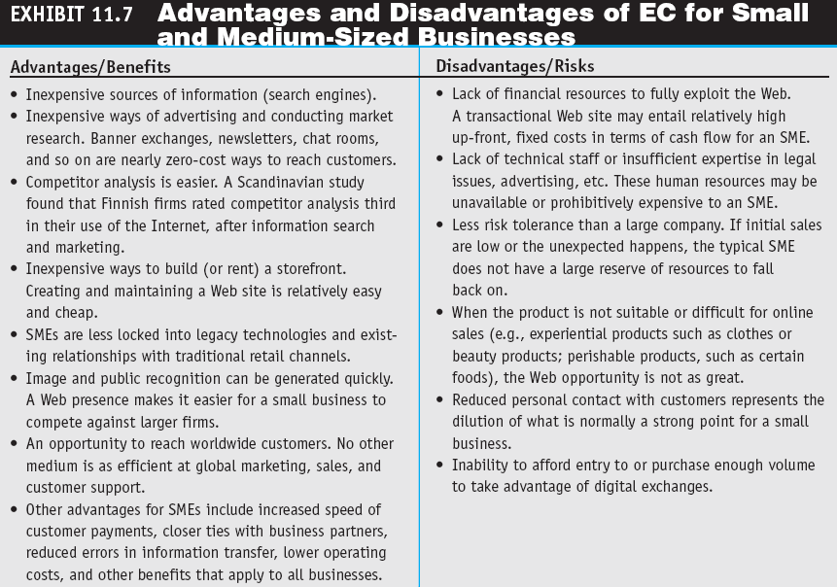

Slide 31
MANAGERIAL ISSUES
What is the strategic value of EC to the organization?
Who determines EC strategy?
What are the benefits and risks of EC?
What metrics should we use?
How do we measure the value of EC investment?

Slide 32
MANAGERIAL ISSUES
How can we go global?
Can we learn to love smallness?
What legal and ethical issues should be of major concern to an EC enterprise?
What are the most critical ethical issues?
How shall we approach EC green computing?

